Slide 1

NeuralNexus
Analysing Neural Regions for Language Processing
Group members :
AmirAli SoltanMohammadi,
Milad Dehnoei,Roza Hamidi,
Zahra Rahimi, and Mahya Nafissi.
Pod : Futalognkosaurus_Gweta
Pod TA: Sara Rostami | Project TA : Yalda Foroutan
Project Mentor : Rousi Wang

Slide 2
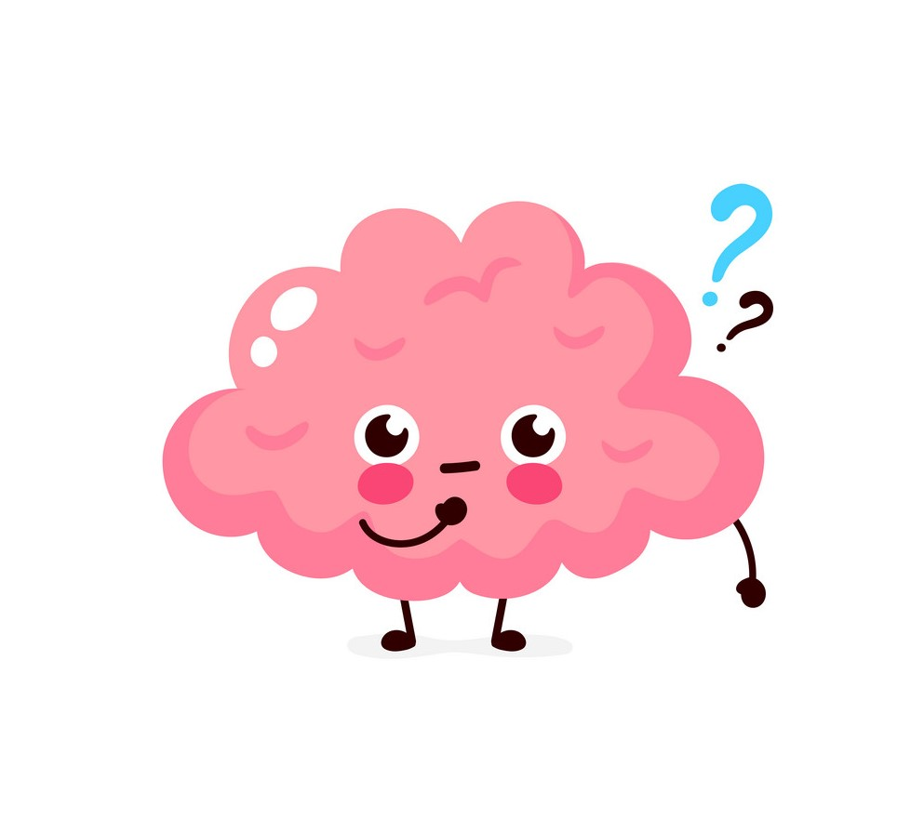

Question
Hypothesis
What are the brain networks that show the greatest difference in activity when solving a math problem versus a story problem?
Some networks of the brain would show different activity patterns while reading a story compared to solving a math problem.

Slide 3

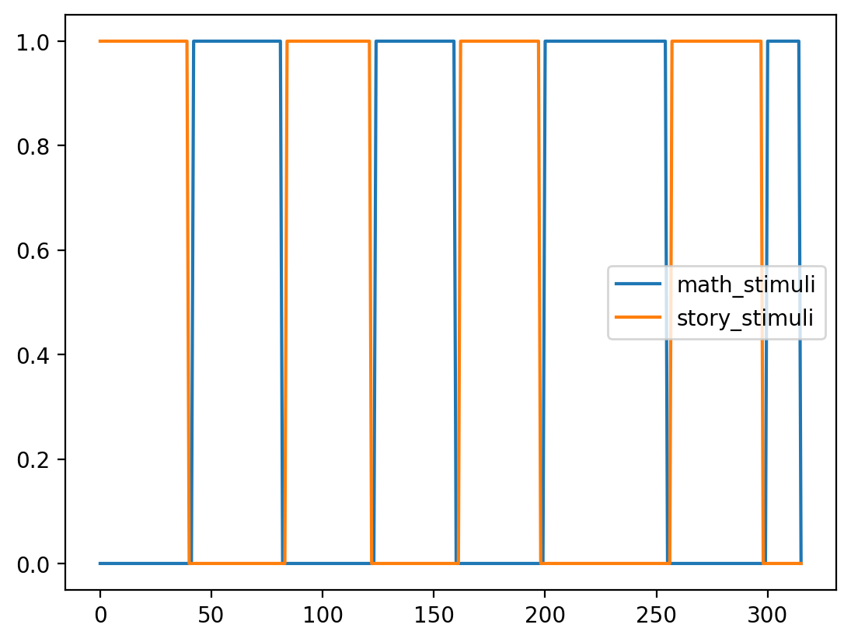

Dataset
HCP dataset:
fMRI data
1200 Subjects 100
Language task: Story/Math
Revenge ?
Reciprocity ?
14 + 12 = ?
29
26
Time
https://www.humanconnectome.org/hcp-protocols-ya-task-fmri#_ENREF_1

Slide 4
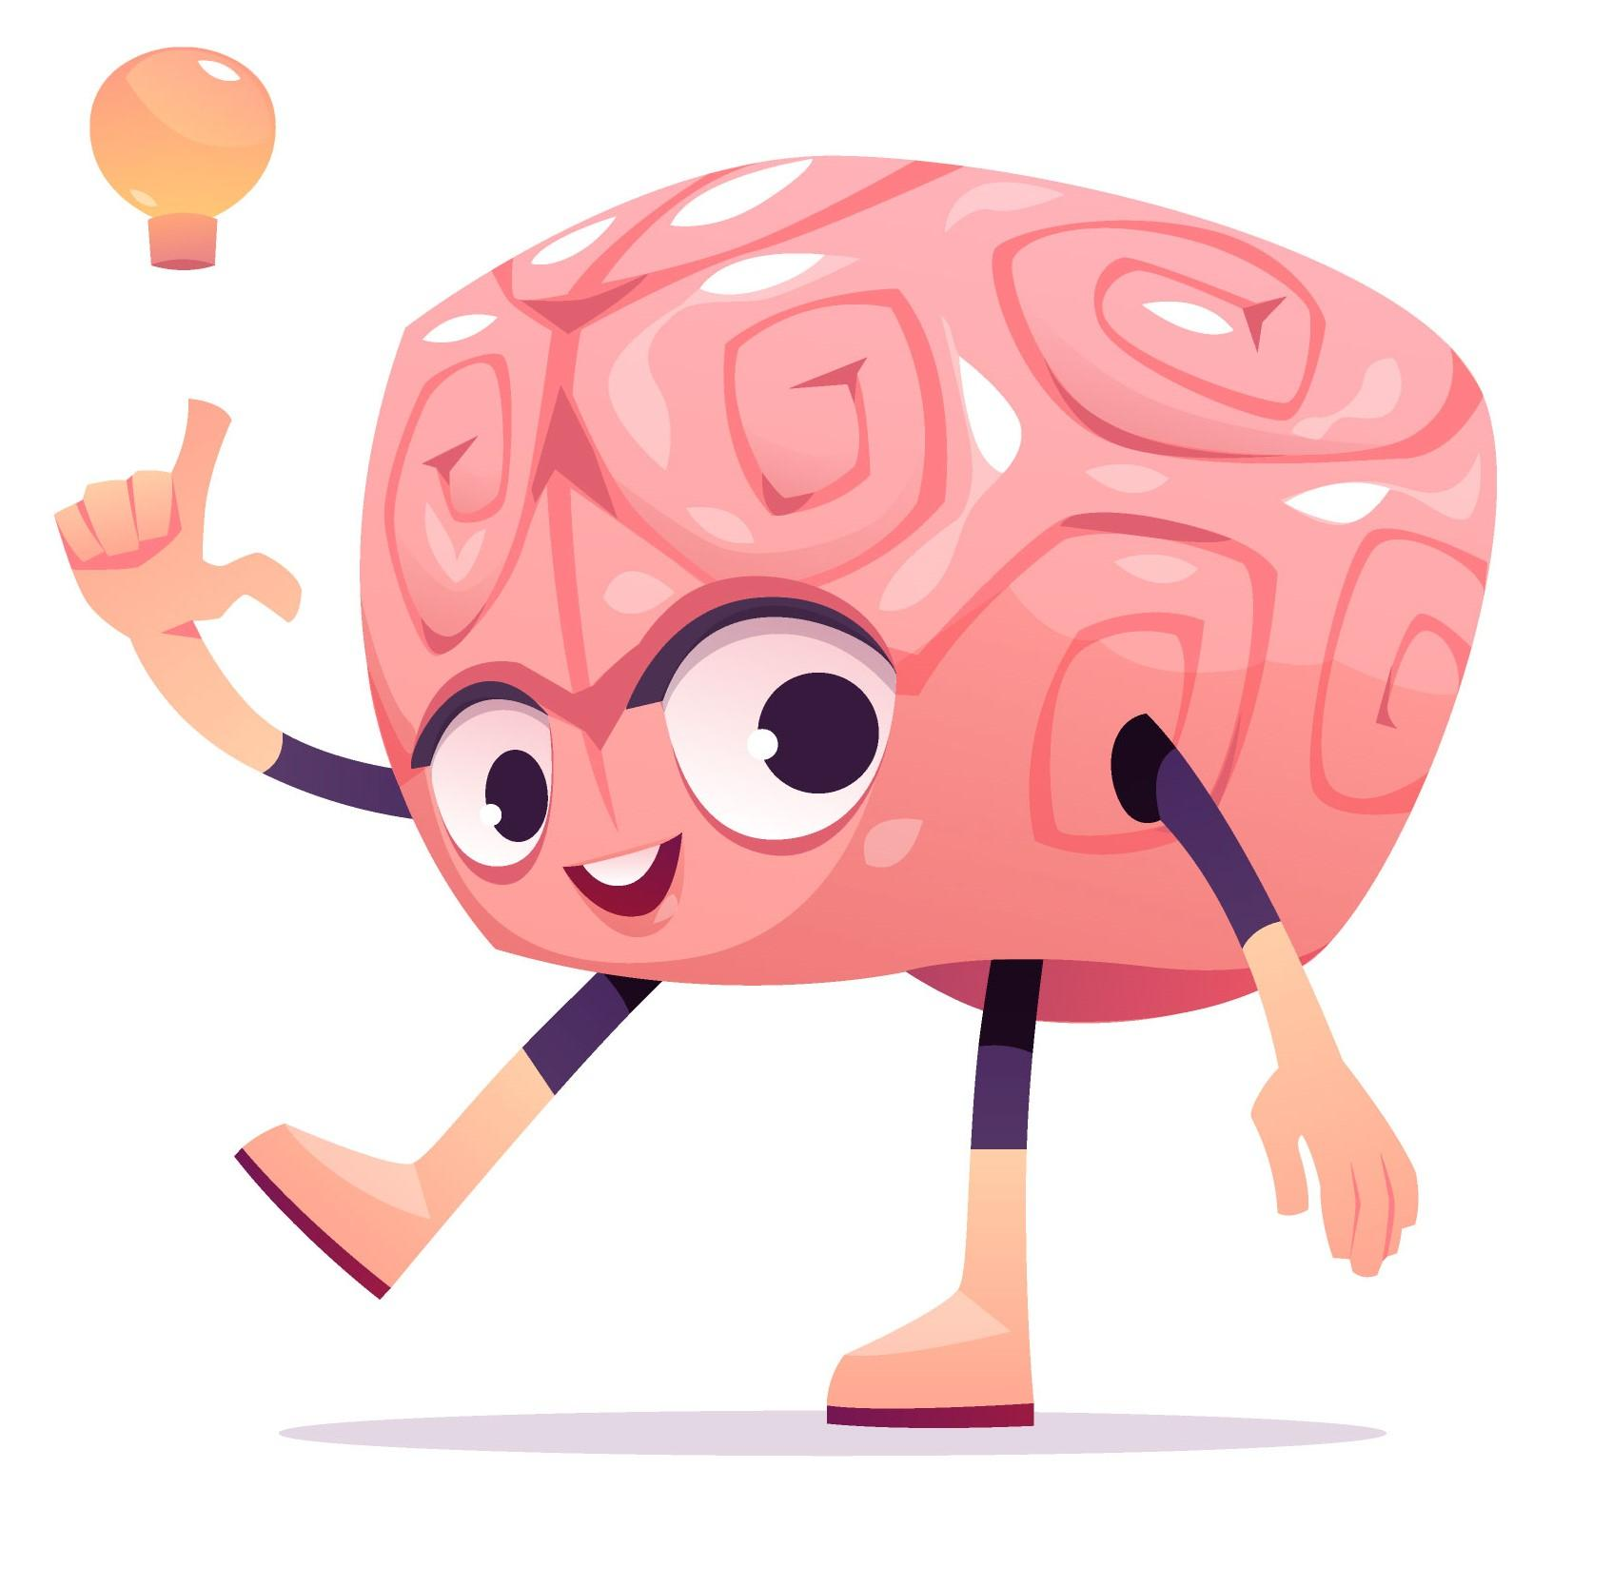
Method
First
Step
Goal networks
Second
Step
Build a model to predict which task the participant was doing
If the model is good enough
Identifying which networks were most important for predicting.

Slide 5
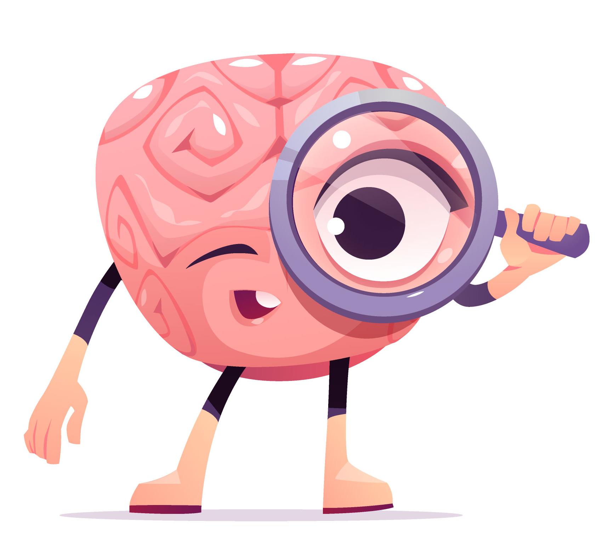
Model
The input to the network is
A Tensor of shape (720, 20)
20 Time step
360(ROIs) x 2(Runs) Neural activity
Residual Block
Stage 1
Convolution
ReLU
Stage 2
Batch Normalization
Convolution
Fully Connected 1
ReLU
Convolution
ReLU
ReLU
Residual Block
Fully Connected 2
Batch Normalization
ReLU
ReLU
ReLU
Max-Pooling
Fully Connected 3
Output
Residual Block
Stage
Proportion of time that the subject was solving a math problem
Loss Function:
Binary Cross Entropy

Slide 6
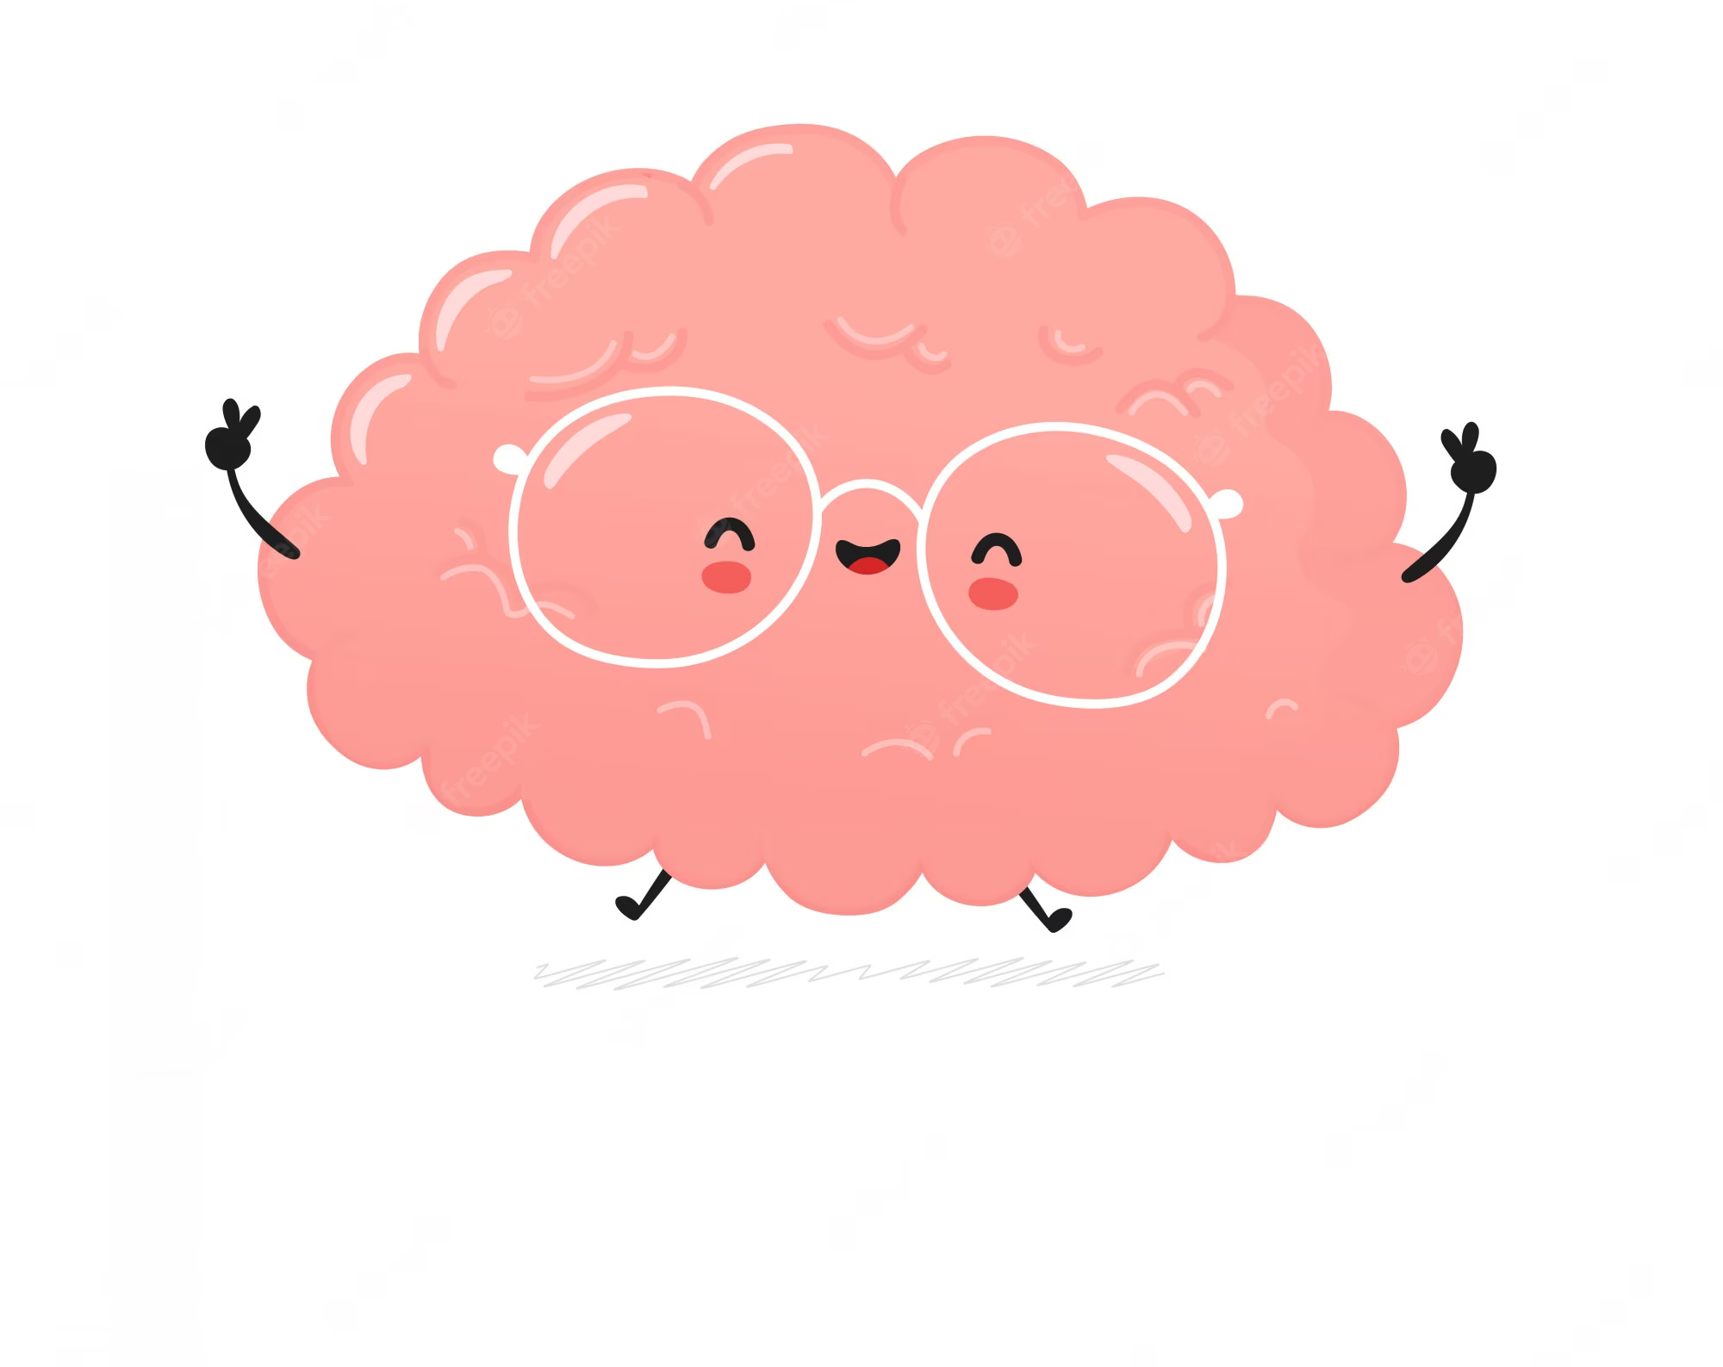
Feature Selection
Permutation Feature Importance is a method for estimating the importance of each brain region in the dataset.
Method:
Randomly shuffles the values of that feature
Measures the change in model error (loss) or decrease in the model's performance.
Purpose:
Making accurate predictions
Understanding how these features contribute to performance.
It only measures relative importance.

Slide 7
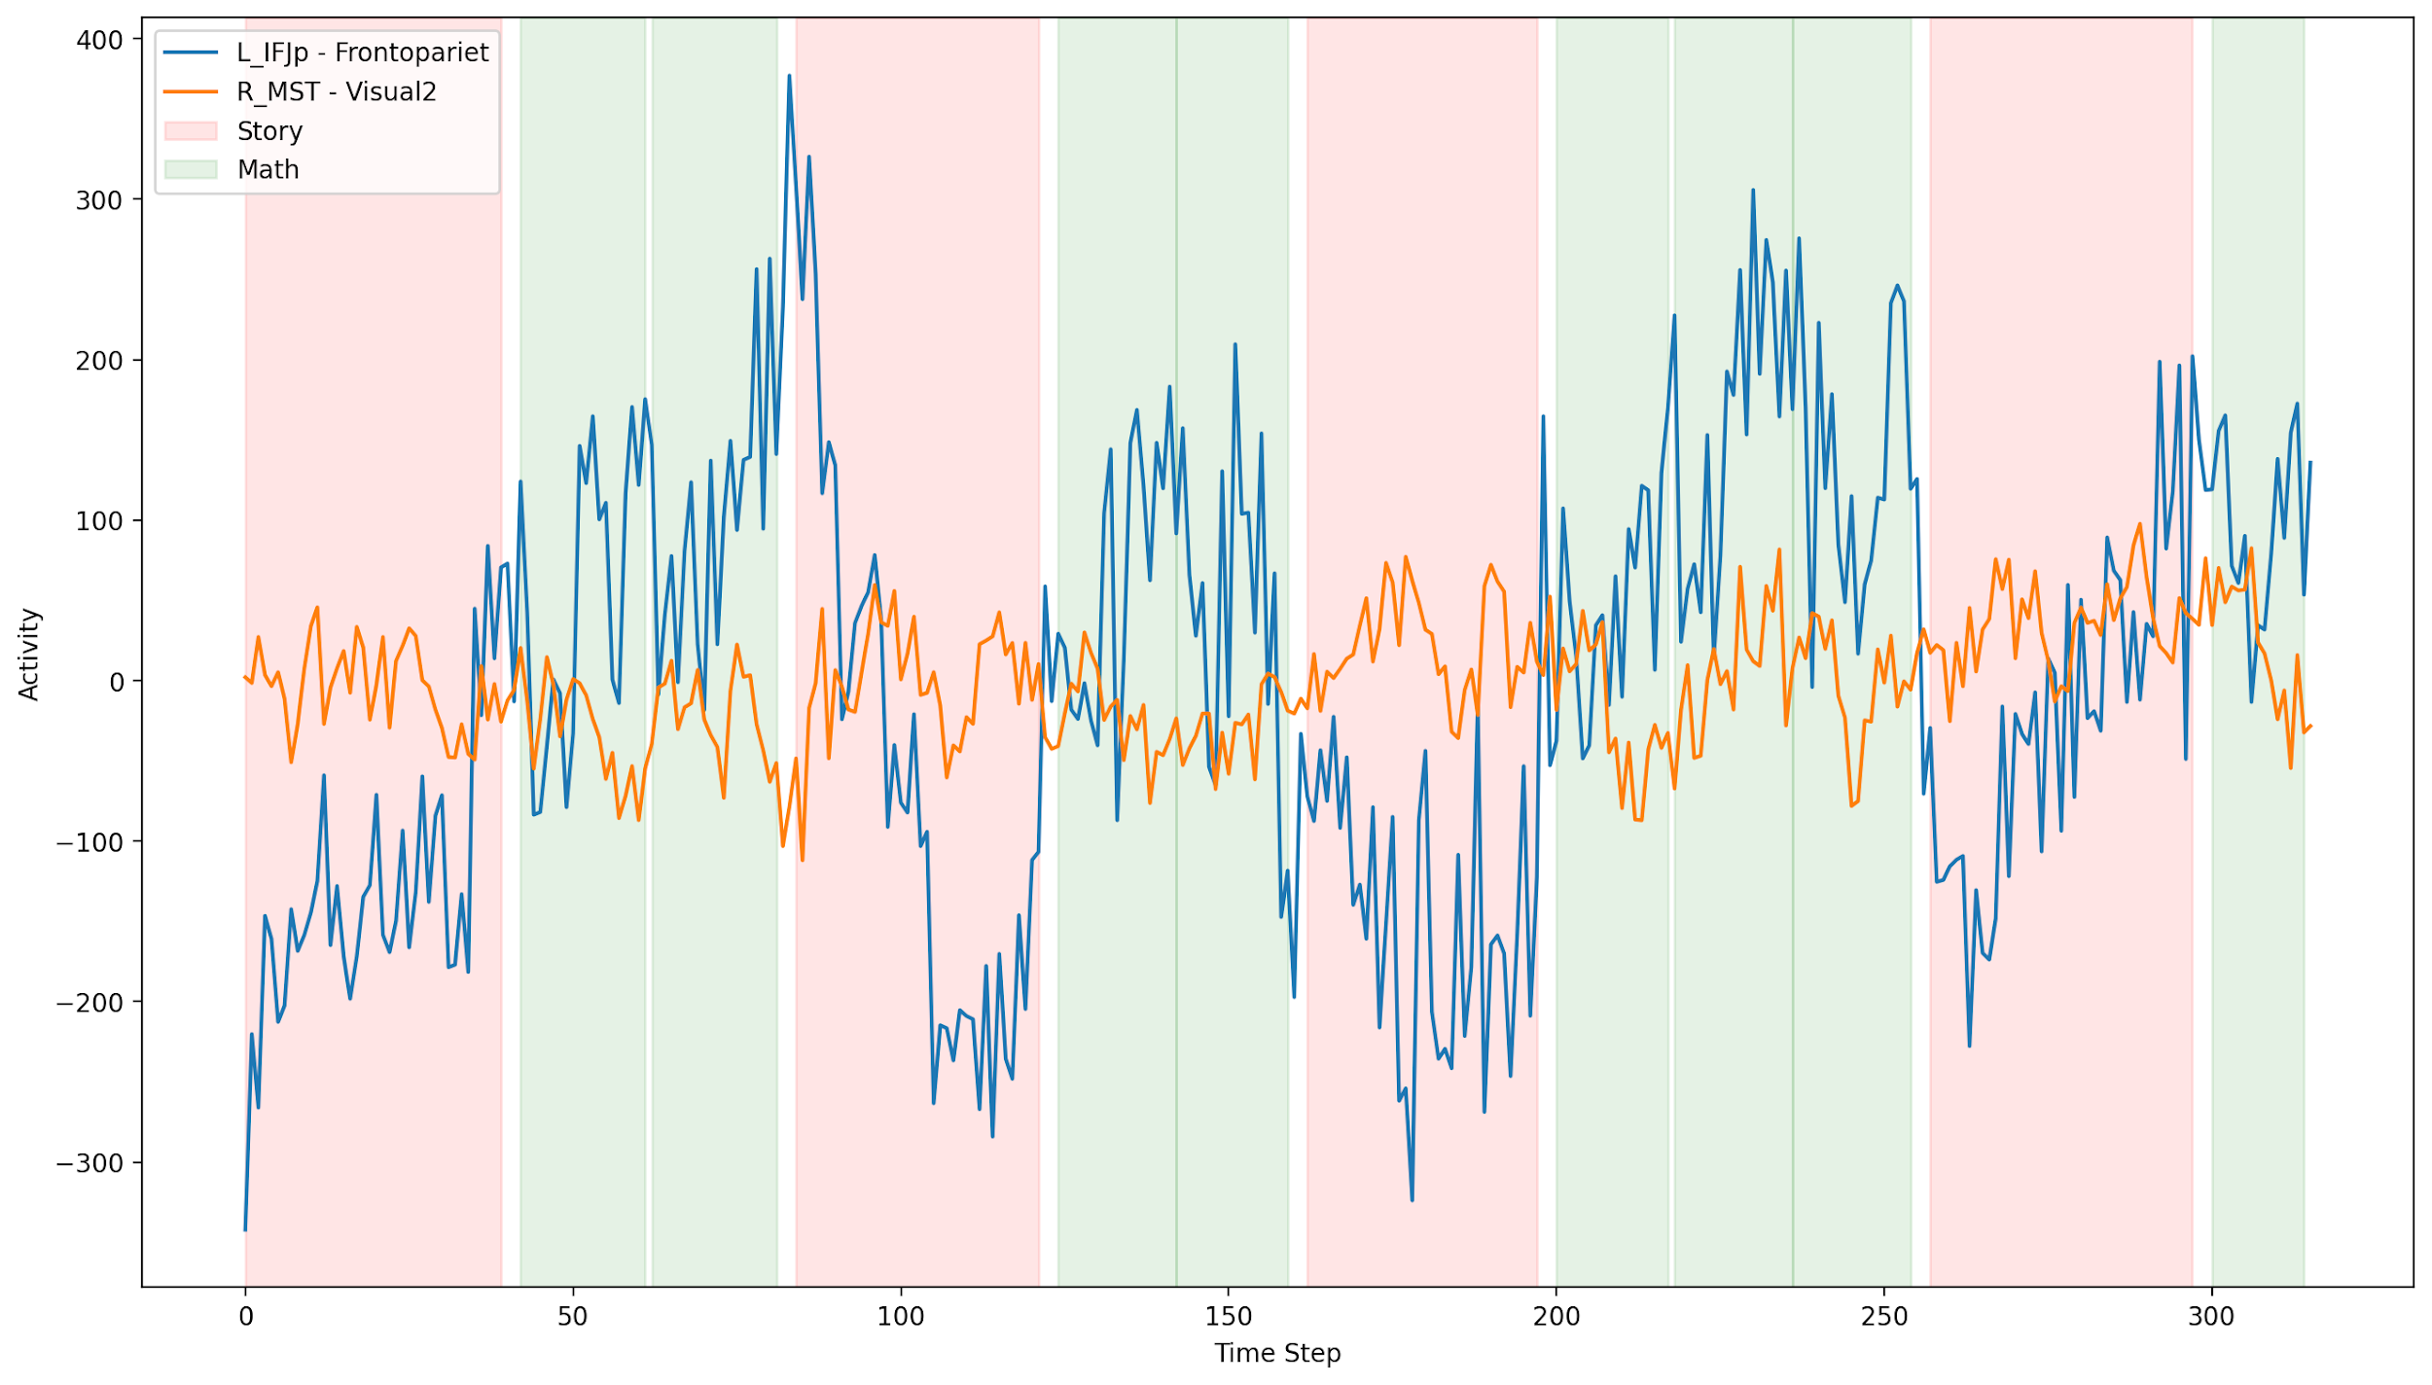
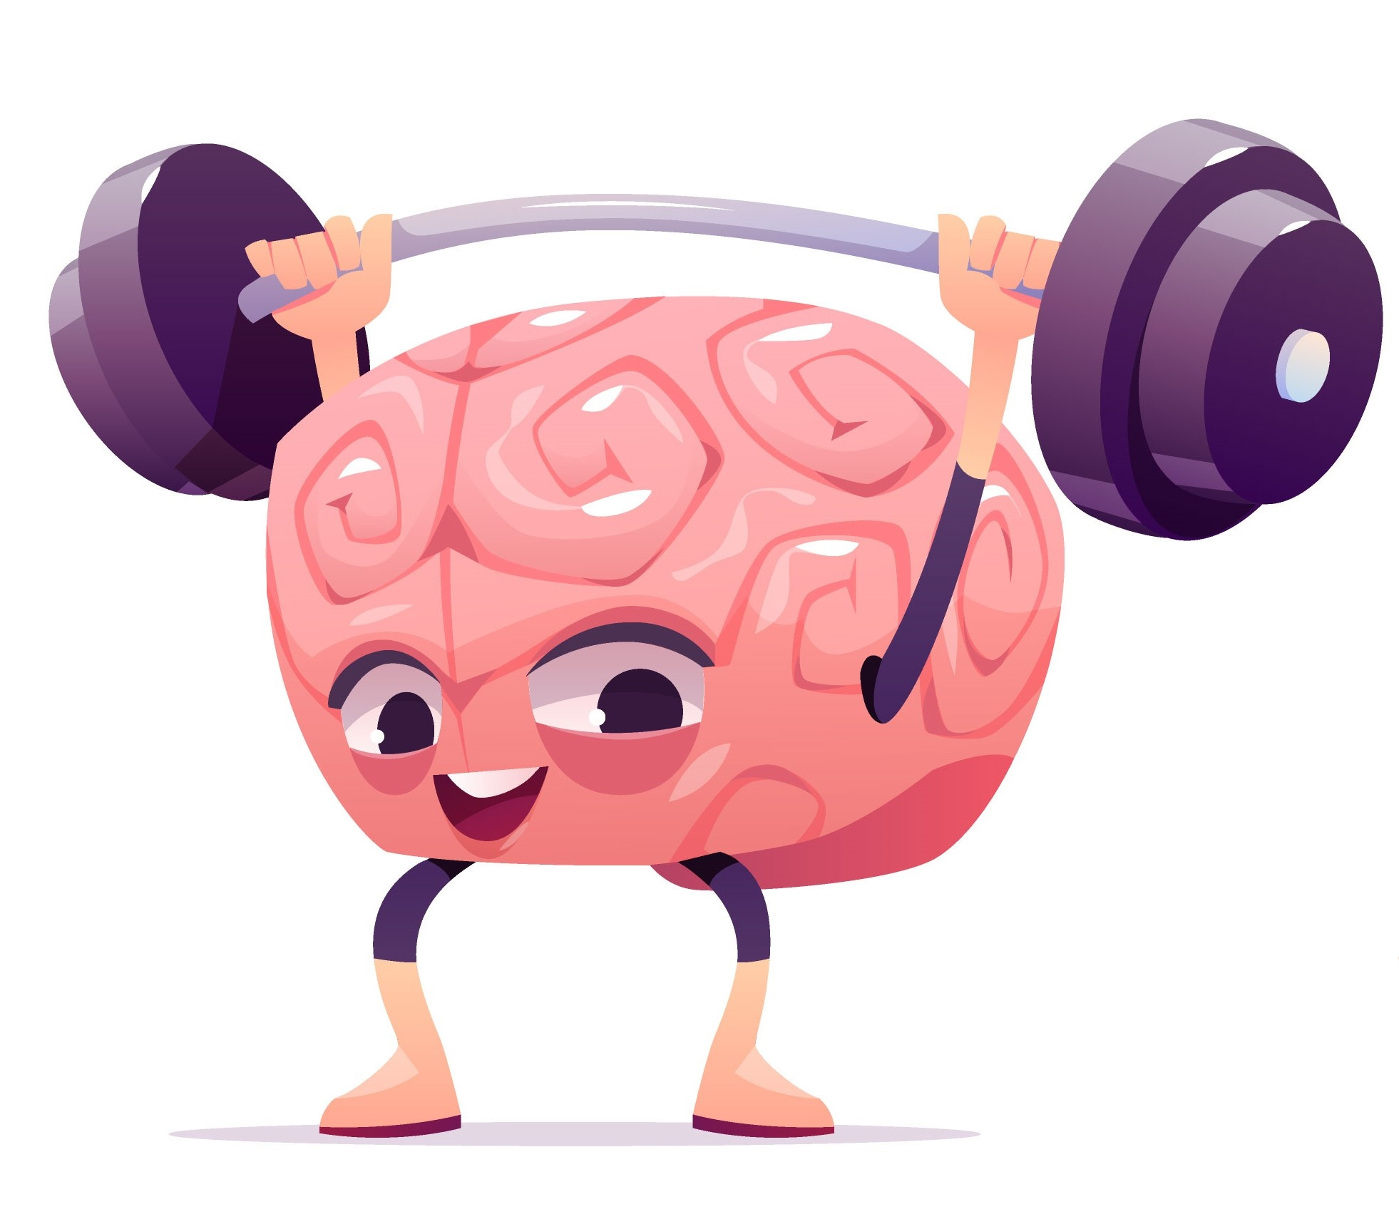
Results
On average, the Cingulo-Opercular and Frontoparietal networks show the greatest difference in activity when subjects are processing math and story stimuli.
Validation accuracy
87%

Slide 8

Thank you !

